Slide 1
CAPSTONE Project for tableau
Customer Churn analysis
Mentor: jaya Pandey
Student: sindupriya itha

Slide 2
Contents
INTRODUCTION
OBJECTIVE
STATISTICS OF THE DATASET – Using Python
OUTLIERS IN THE DATASET
VISUALIZING THE OUTLIERS WITH BOX PLOT
IDENTIFYING AND IMPUTING THE MISSING VALUES
CLEANED DATA
VISUALIZATION OF TABLEAU – Using Tableau
ANALYSIS OF TABLEAU
OBSERVATIONS
CONCLUSION

Slide 3
Introduction
Key Insights: Discover the critical findings that analysis has uncovered, shedding light on customer behavior and potential churn triggers.
Visualizing the Data: Showcase visually using Tableau dashboards that bring the data to life and make complex information easy to understand.
Interpretations: Based on findings, interpretations have been made that helps to identify the key factors contributing to churn, and ultimately empower to make data-driven decisions to retain and grow customer base.

Slide 4
Objective
The objective of this presentation is to analyze, provide a comprehensive view of churn analysis and understand customer churn within the banking industry using data-driven insights.
We will identify the key factors contributing to churn and provide interpretations based on the analysis.

Slide 5
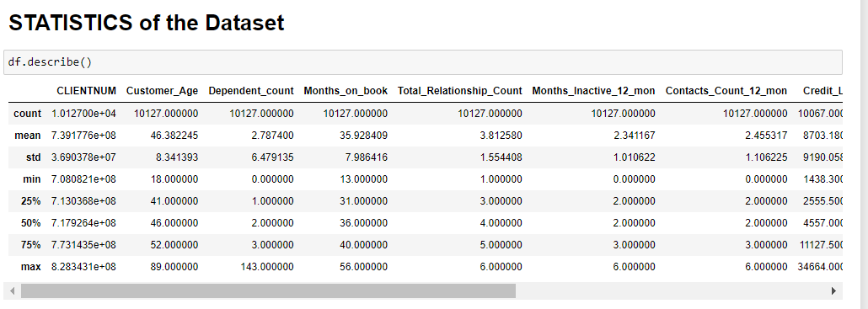
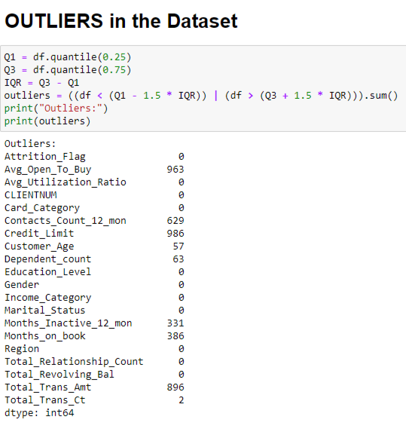
Statistics of the dataset
OUTLIERS

Slide 6
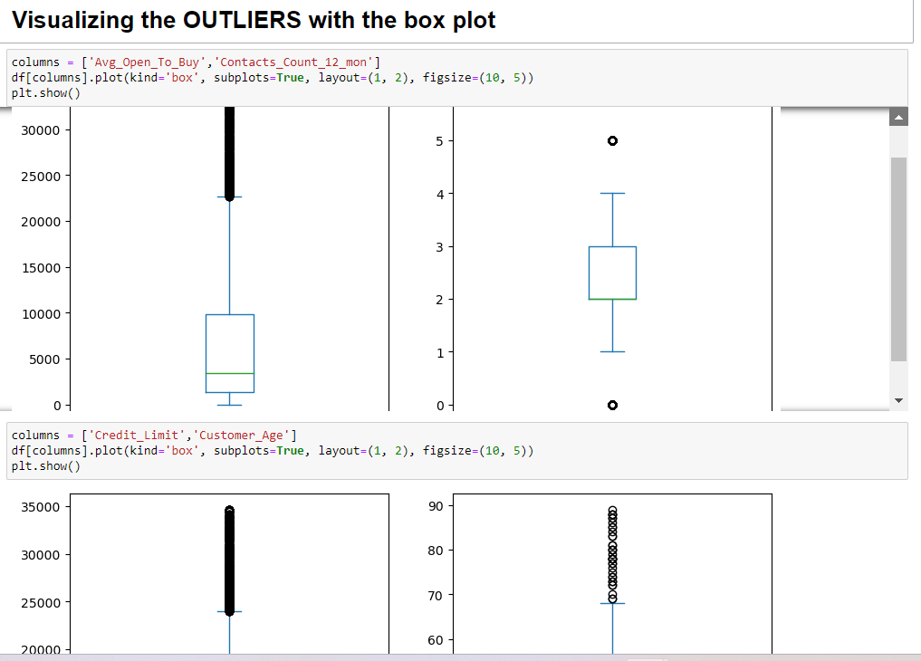
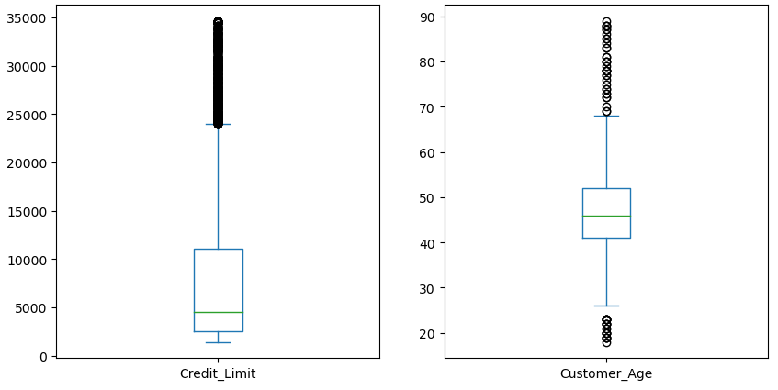
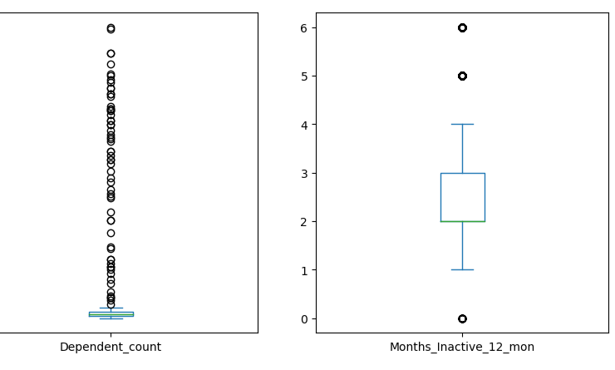
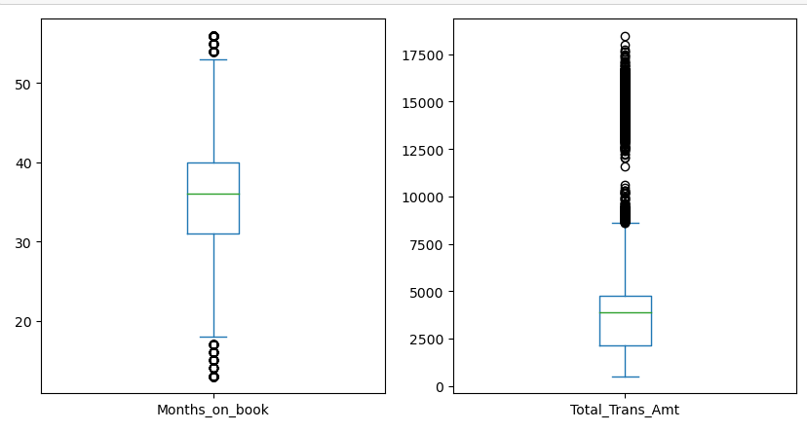
VISUALIZING THE OUTLIERS WITH BOX PLOT

Slide 7
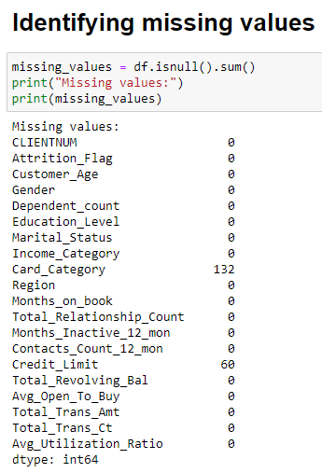
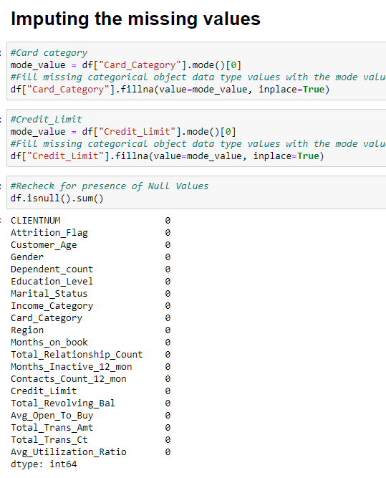
IDENTIFYING AND IMPUTING THE MISSING VALUES
Cleaned Data

Slide 8
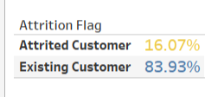
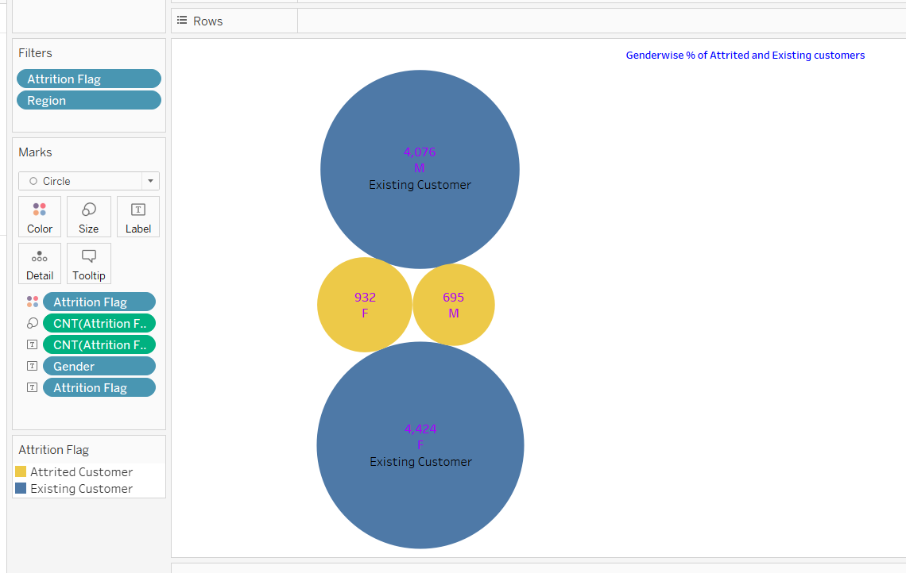
VISUALIZATION using TABLEAU
Interpretation: Existing customers are more than attrited customers from the data
Interpretation: Female members are more in both Attrited customers and existing customers.

Slide 9
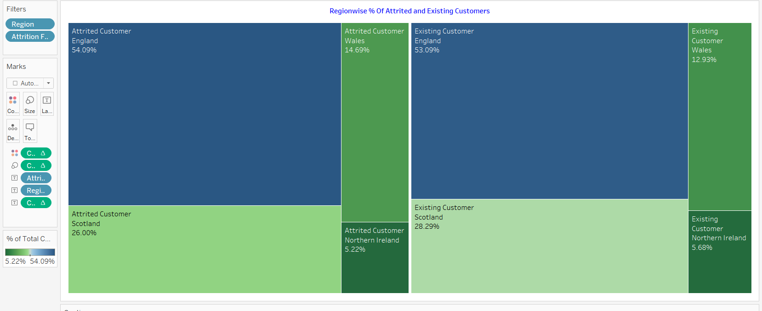
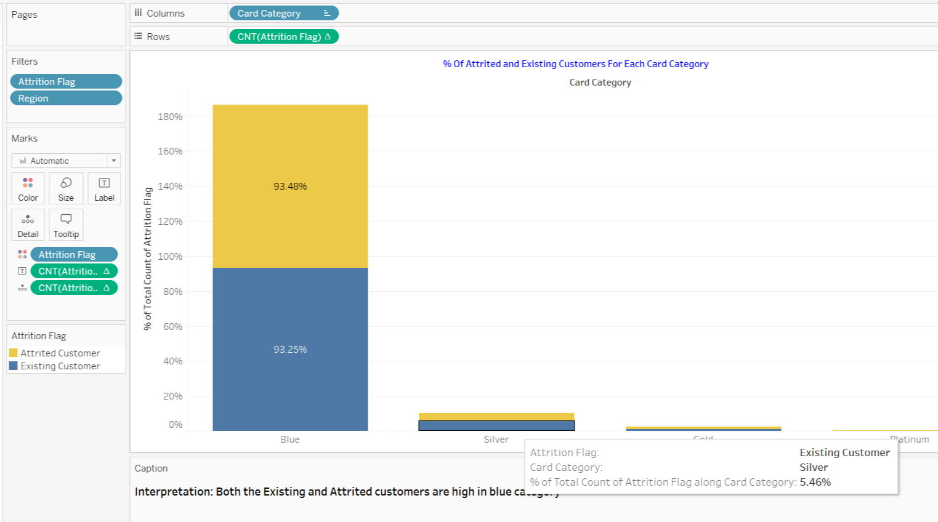
Interpretation: The attrited Customers and Existing Customers are high in England where as they both are low in numbers in Northern Island
Interpretation: Both the Existing and Attrited customers are high in blue category

Slide 10
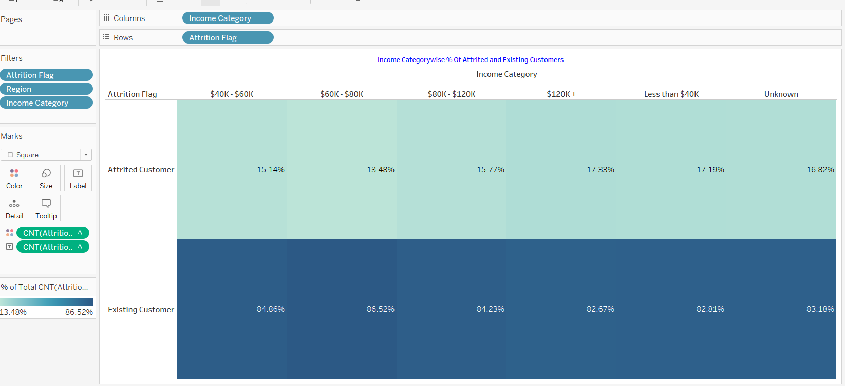
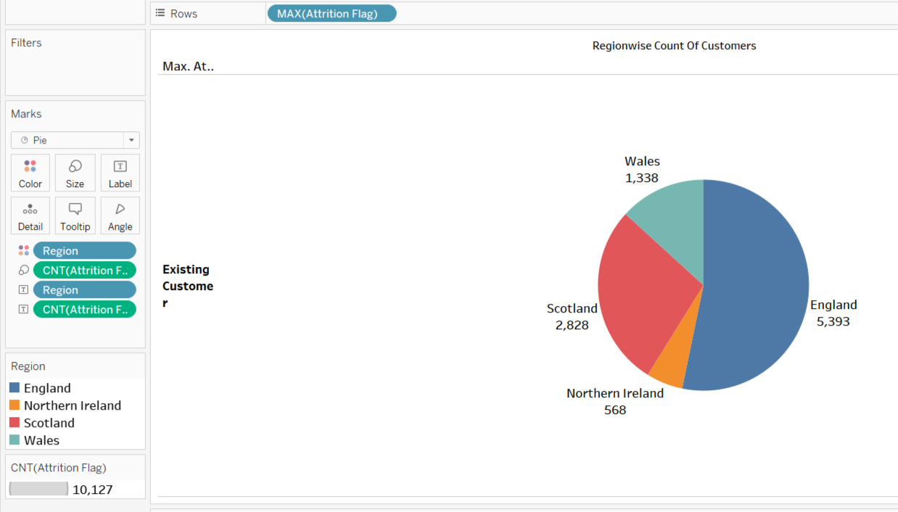
Interpretation: Existing customers in all income categories ae more than attrited customers
Interpretation:
England has the highest number of customers i.e., 5393

Slide 11
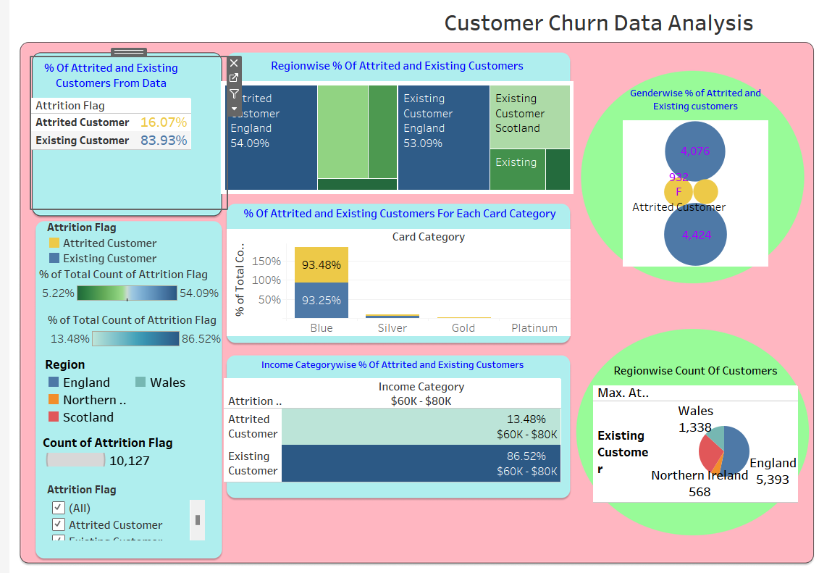

Slide 12
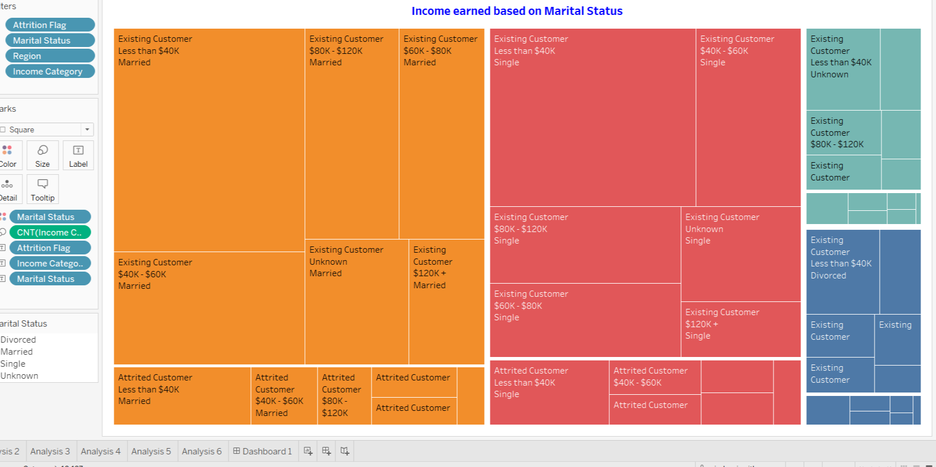
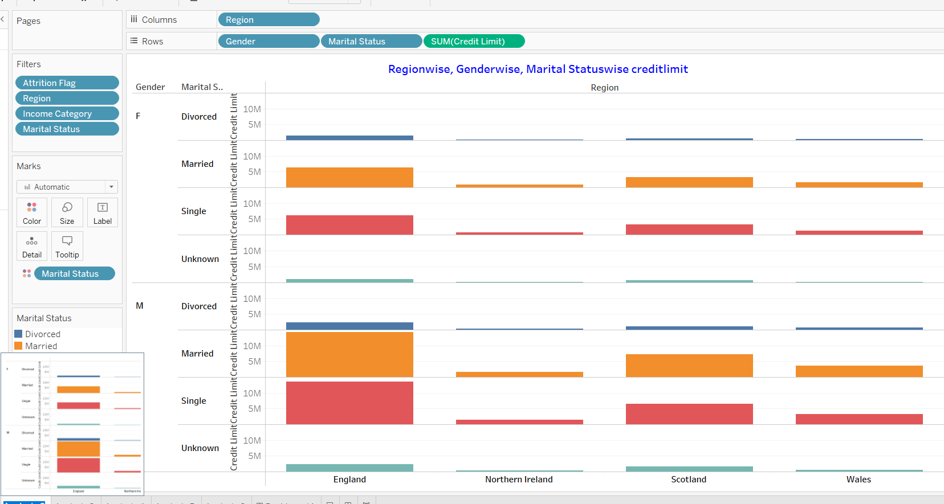
Additional Analysis
Interpretation: Marital Status has a direct relationship with income earned. Married customers in both cases earned high
Interpretation: Females both married and single has given higher credit limit than males in England

Slide 13
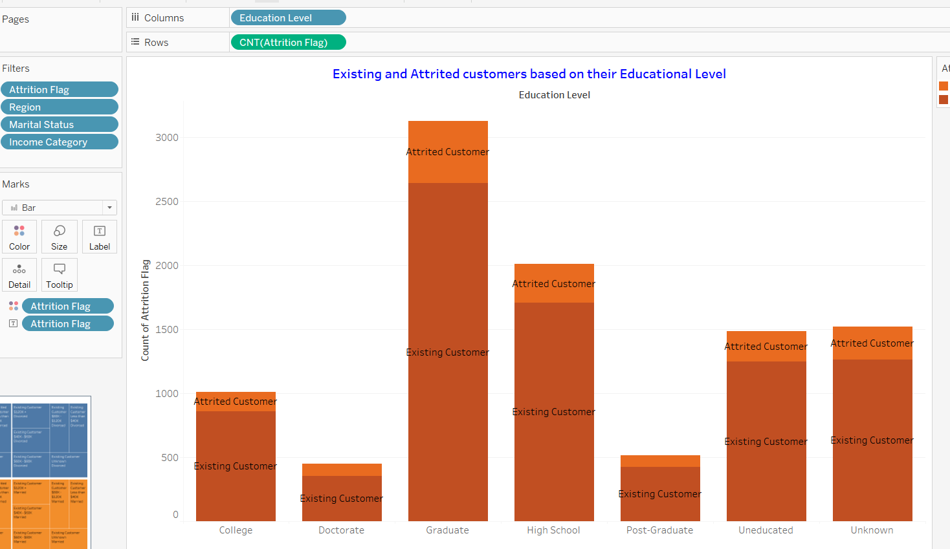
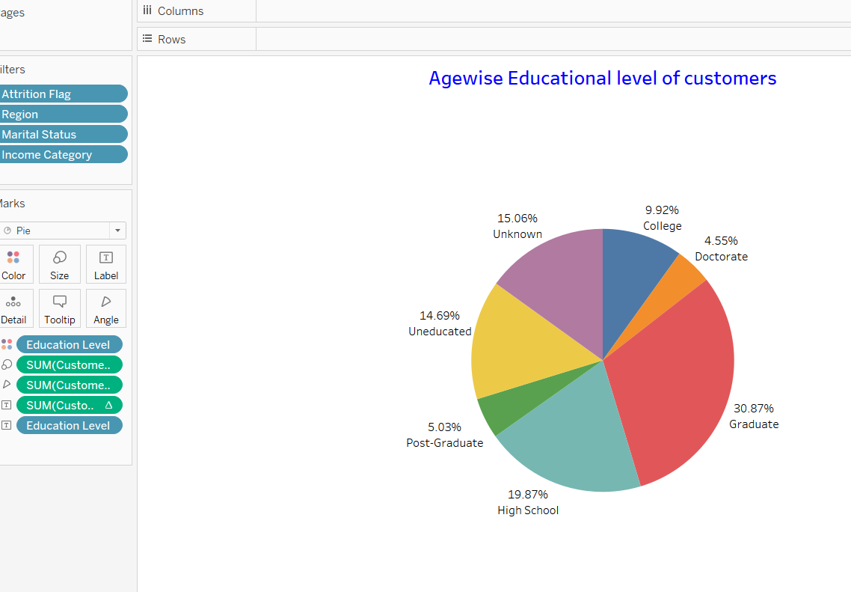
Interpretation: The number of Existing customers are more in all educated categories
Interpretation: Most of the customers have completed their Graduation studies.

Slide 14
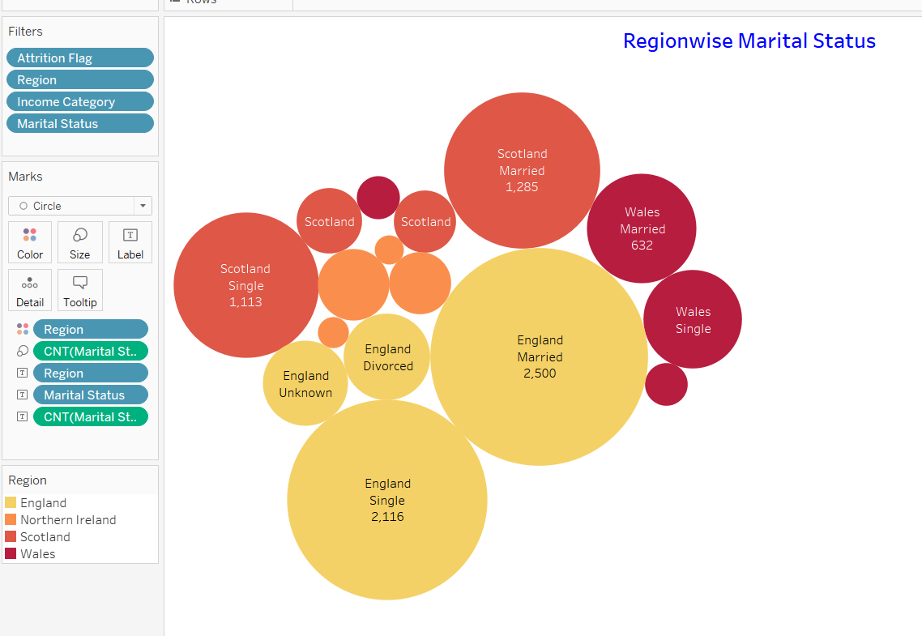
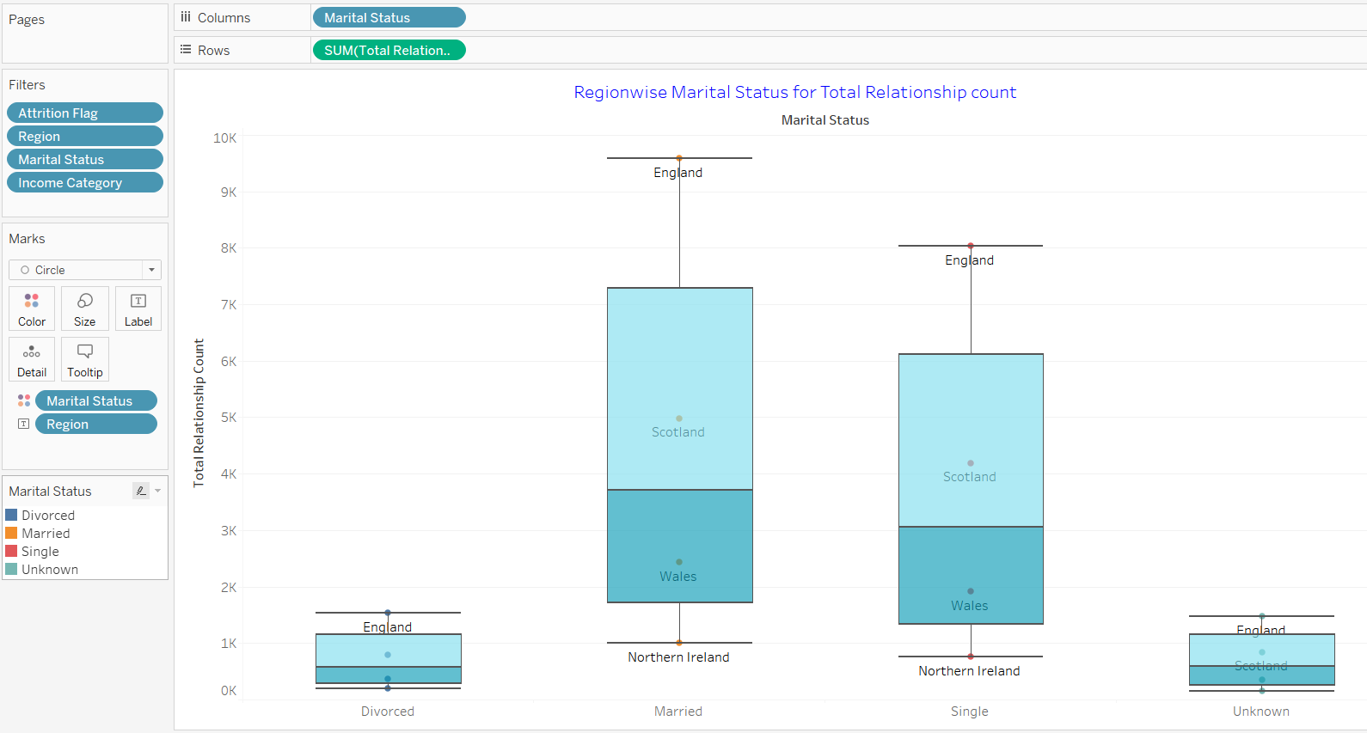
Interpretation: England has the highest number of married people and Northern Island has the lowest Divorce rate
Interpretation: England has more number of married more and has lowest rates of Divorces.

Slide 15
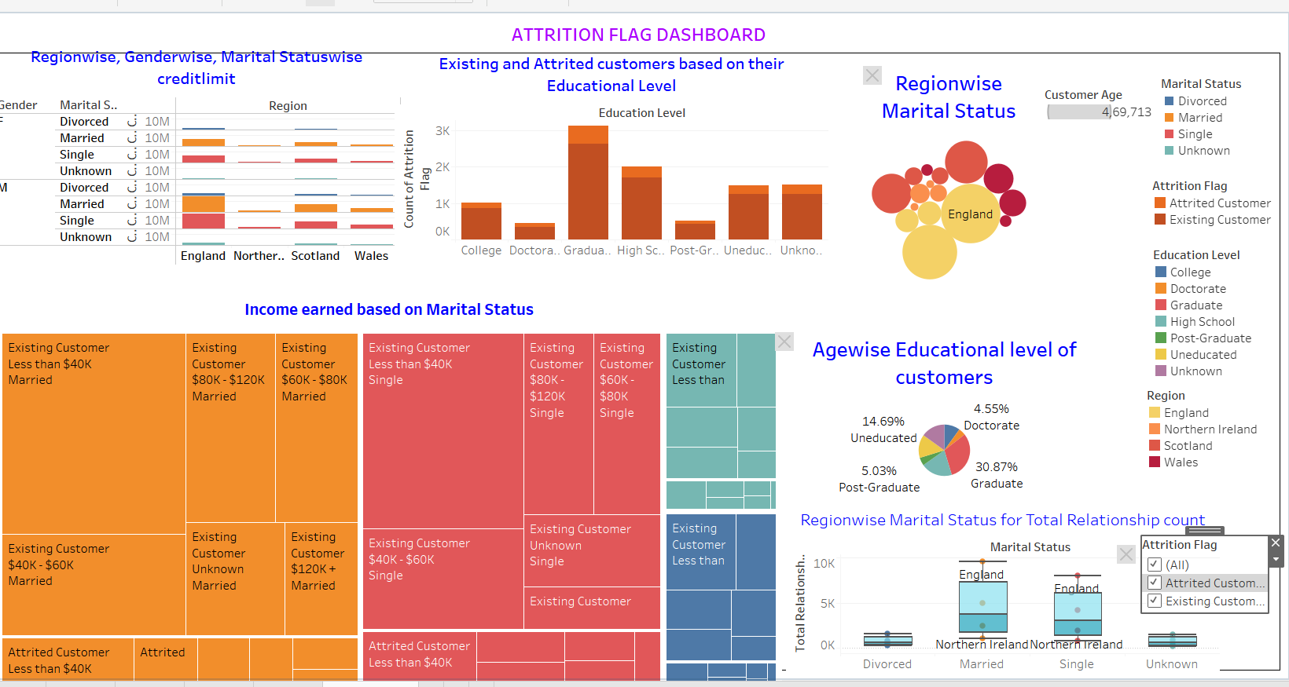

Slide 16
OBSERVATIONS
From the data analysis, we can infer the following observations regarding existing and attired customers:
Regional Distribution: Existing and attired customers are more concentrated in England, which indicates that England has a higher customer base for the company compared to other regions.
Educational Background: Regardless of their attrition status, customers are well-educated, with a significant number having completed their graduation. This suggests that education level may not be a strong differentiator between existing and attired customers.
Income and Marital Status: Marital status seems to be a factor influencing income earned, with married customers generally having higher incomes. This may imply that married customers are more financially stable.
Credit Limits by Gender: In England, females, both married and single, are granted higher credit limits than males. This could be a strategic decision by the company, taking into account risk assessment or market dynamics.
Customer Numbers: There is a significant imbalance between existing and attired customers, with a much larger number of existing customers. This could indicate challenges in customer retention or a natural attrition rate within the business.
Regional Differences in Attrition: Attrition rates vary by region, with England having a higher number of both existing and attired customers. Northern Ireland, on the other hand, has lower numbers of both customer categories. This could be due to regional business conditions or customer preferences.
Gender Distribution: The data indicates that female customers are more in numbers both the attrited and existing customer groups.

Slide 17
CONCLUSION
To conclude, the data provides several insights, but more detailed analysis is required to draw definitive conclusions about the factors influencing attrition among customers.
The provided data analysis gives a starting point and further investigations into customer behavior and attrition causes is needed.

Slide 18


